Slide 1
Skin/Benign/Palliation 2010~2018
陳韻之

Slide 2
2019 | ?? (蔡玉真今年不是口委) | 吳錦榕 (slide 3~7)
2018 | 呂志德 | 吳錦榕
2017 | 蔡玉真 | 吳錦榕
2016 | 蔡玉真 | 梁雲
2015 | 蔡玉真 | 吳錦榕
2014 | 蔡玉真 | 劉岱瑋
2013 | 任益民 | 吳孟浩
2012 | 呂志德 | 吳孟浩
2011 | 許文林 | 蔡若婷
2010 | 顏上惠 | 吳孟浩

Slide 3
Skin 2018/吳錦榕
Skin cancer RT 的 indication?
A: RT is preferred for
p’t > 60 y/o and not candidates for primary surgery.
Lesions at central face, lip, eyelid and ears (inferior cosmetic or functional outcome after surgery)
Adj. RT to primary sites with skin cancer:
Margin(+)
Extensive PNI or large nerve
Invasion of bone/cartilage or skeletal muscle
2. BCC或SCC手術完要不要照lymphatic drainage?
A: Adj. nodal RT indication:
T3/T4
Multiple LN(+)
Large LN (>3cm)
Close neck dissection margin
Melanoma RT 的角色？
A: Definitive in medically inoperable and lentiho maligna of the face;
Adjuvant in deep desmoplastic melanoma with narrow margins, recurrence disease, and stage III with ENE(+)

Slide 4
Benign 2015,2018/吳錦榕
Benign disease 目前 RT 有什麼角色？(自由發揮), 你的實作經驗如何?
A: - Pigmented Villonodular Synovitis (PVNS): adjuvant RT (36-50 Gy) in diffuse pattern, bulky or multiple recurrence case.
Paraganglioma: PORT 50Gy (有遇過carotid body paraganglioma, 當時definitive RT 54Gy)
Keloids/Hypertrophic scars: 12-20Gy/3-4Fx or 7.5-10Gy/Fx, 術後24hrs內RT
Pituitary adenoma: SRS 20Gy
AVM: SRS 22Gy to 50% IDL
有沒有治療過benign disease，說明一下。
A: Tx of Keloid: surgery, RT, steroid injection, cryotherapy, laser…
Steroid control rate: 60%/ RT control rate: 65-90%
post-op RT timing: within 24hrs
QoL improved, but RT side effect includes: hyperpigmentation, pruritis and erythema 。

Slide 5
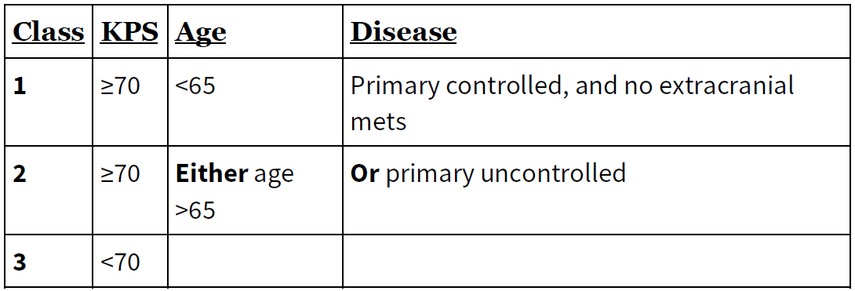
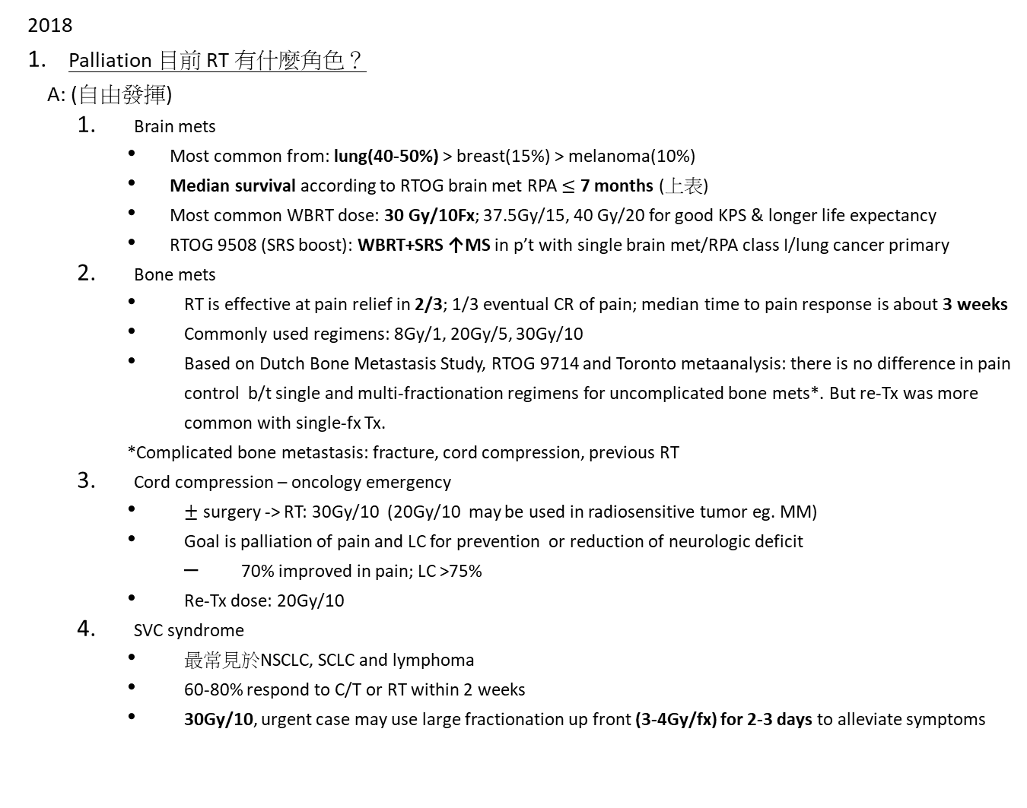
Palliation 2015,2018/吳錦榕
2018
Palliation 目前 RT 有什麼角色？
A: (自由發揮)
Brain mets
Most common from: lung(40-50%) > breast(15%) > melanoma(10%)
Median survival according to RTOG brain met RPA $≤$ 7 months (上表)
Most common WBRT dose: 30 Gy/10Fx; 37.5Gy/15, 40 Gy/20 for good KPS & longer life expectancy
RTOG 9508 (SRS boost): WBRT+SRS ↑MS in p’t with single brain met/RPA class I/lung cancer primary
Bone mets
RT is effective at pain relief in 2/3; 1/3 eventual CR of pain; median time to pain response is about 3 weeks
Commonly used regimens: 8Gy/1, 20Gy/5, 30Gy/10
Based on Dutch Bone Metastasis Study, RTOG 9714 and Toronto metaanalysis: there is no difference in pain control b/t single and multi-fractionation regimens for uncomplicated bone mets*. But re-Tx was more common with single-fx Tx.
*Complicated bone metastasis: fracture, cord compression, previous RT
Cord compression – oncology emergency
$±$ surgery -> RT: 30Gy/10 (20Gy/10 may be used in radiosensitive tumor eg. MM)
Goal is palliation of pain and LC for prevention or reduction of neurologic deficit
70% improved in pain; LC >75%
Re-Tx dose: 20Gy/10
SVC syndrome
最常見於NSCLC, SCLC and lymphoma
60-80% respond to C/T or RT within 2 weeks
30Gy/10, urgent case may use large fractionation up front (3-4Gy/fx) for 2-3 days to alleviate symptoms
Notes:
Complicated bone metastasis: fracture, cord compression, previous RT.
SVC obstruction does not predict poor outcomes in p’t with treatment-responsive tumor compared to those without SVC

Slide 6
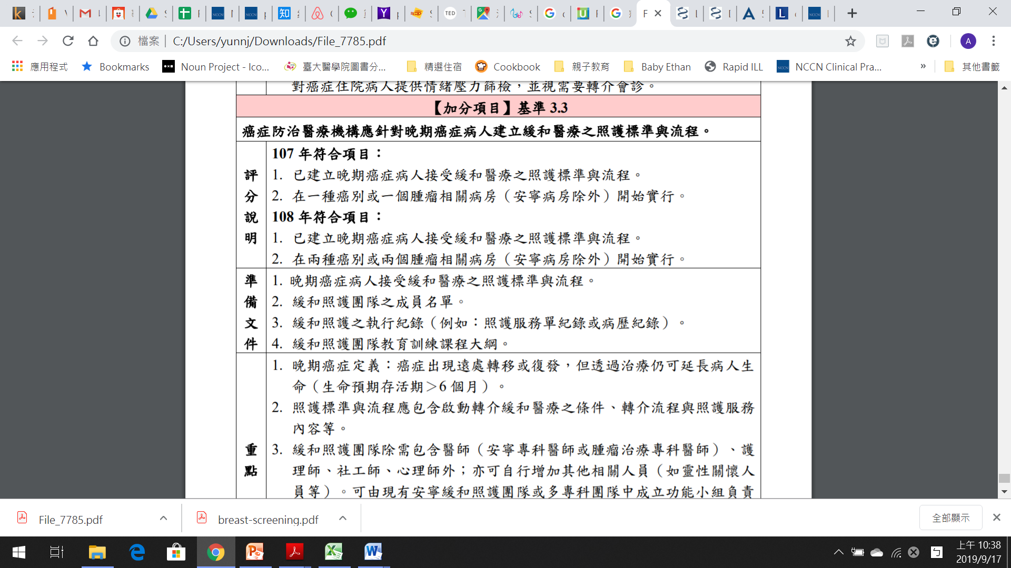
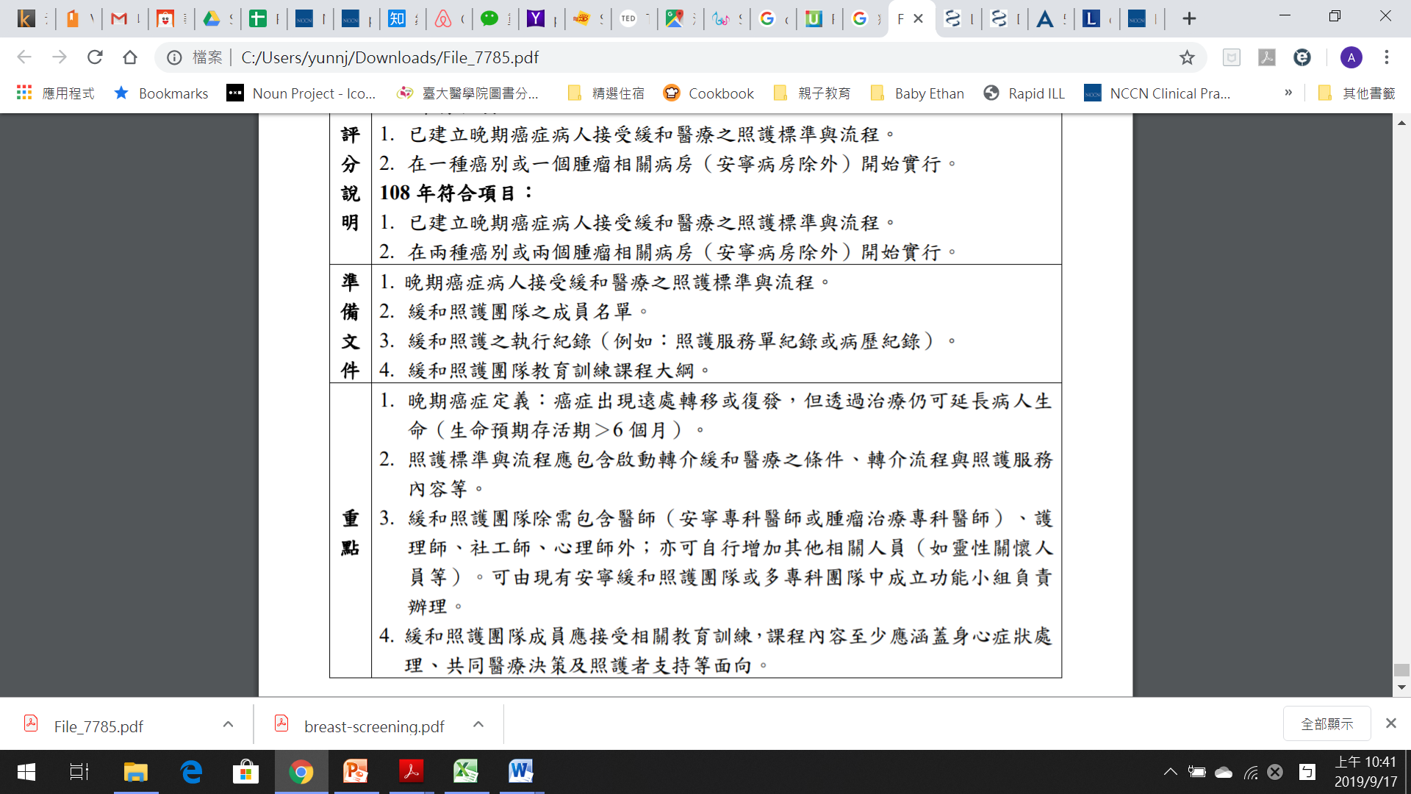
Palliative RT for bone mets 是否增加 survival? (ENABLE III trial) 增加多少?
癌症評鑑條文3.3內容是什麼？A: 癌症防治醫療機構應針對晚期癌症病人建立緩和醫療之照護標準與流程 (要有安寧團隊.....

Slide 7
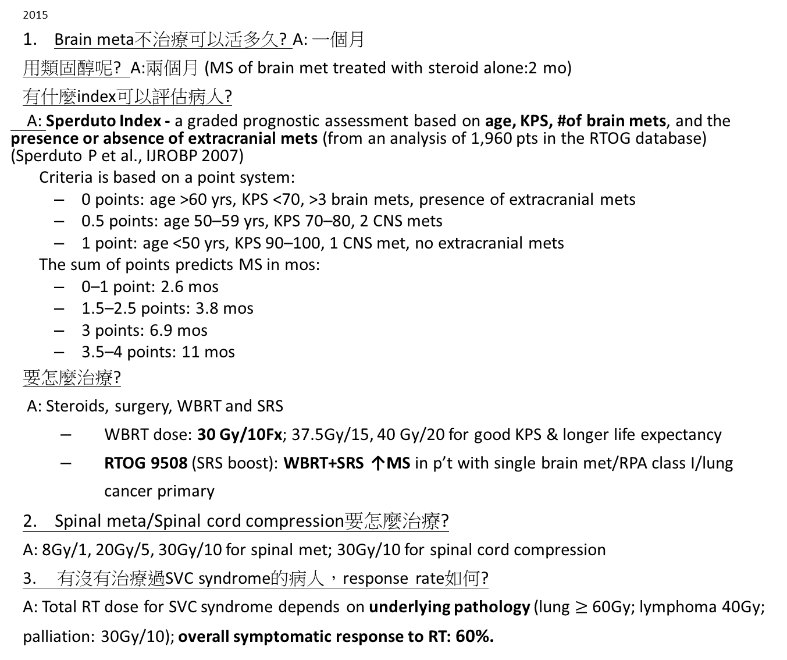
2015
Brain meta不治療可以活多久? A: 一個月
用類固醇呢? A:兩個月 (MS of brain met treated with steroid alone:2 mo)
有什麼index可以評估病人?
A: Sperduto Index - a graded prognostic assessment based on age, KPS, #of brain mets, and the presence or absence of extracranial mets (from an analysis of 1,960 pts in the RTOG database) (Sperduto P et al., IJROBP 2007)
Criteria is based on a point system:
0 points: age >60 yrs, KPS <70, >3 brain mets, presence of extracranial mets
0.5 points: age 50–59 yrs, KPS 70–80, 2 CNS mets
1 point: age <50 yrs, KPS 90–100, 1 CNS met, no extracranial mets
The sum of points predicts MS in mos:
0–1 point: 2.6 mos
1.5–2.5 points: 3.8 mos
3 points: 6.9 mos
3.5–4 points: 11 mos
要怎麼治療?
A: Steroids, surgery, WBRT and SRS
WBRT dose: 30 Gy/10Fx; 37.5Gy/15, 40 Gy/20 for good KPS & longer life expectancy
RTOG 9508 (SRS boost): WBRT+SRS ↑MS in p’t with single brain met/RPA class I/lung cancer primary
2. Spinal meta/Spinal cord compression要怎麼治療?
A: 8Gy/1, 20Gy/5, 30Gy/10 for spinal met; 30Gy/10 for spinal cord compression
3. 有沒有治療過SVC syndrome的病人，response rate如何?
A: Total RT dose for SVC syndrome depends on underlying pathology (lung $≥$ 60Gy; lymphoma 40Gy; palliation: 30Gy/10); overall symptomatic response to RT: 60%.
Notes:
SVC syndrome:
最常見於NSCLC, SCLC and lymphoma
60-80% respond to C/T or RT within 2 weeks
30Gy/10, urgent case may use large fractionation up front (3-4Gy/fx) for 2-3 days to alleviate symptoms

Slide 8
Skin

Slide 9
2018/吳錦榕
Skin cancer RT 的 indication?
A: RT is preferred for
p’t > 60 y/o and not candidates for primary surgery.
Lesions at central face, lip, eyelid and ears (inferior cosmetic or functional outcome after surgery)
Adj. RT to primary sites with skin cancer:
Margin(+)
Extensive PNI or large nerve
Invasion of bone/cartilage or skeletal muscle
2. BCC或SCC手術完要不要照lymphatic drainage?
A: Adj. nodal RT indication:
T3/T4
Multiple LN(+)
Large LN (>3cm)
Close neck dissection margin
Melanoma RT 的角色？
A: Definitive in medically inoperable and lentiho maligna of the face;
Adjuvant in deep desmoplastic melanoma with narrow margins, recurrence disease, and stage III with ENE(+)

Slide 10
2011/蔡若婷
關於皮膚癌有哪些情況下適合RT? 有哪些risk factor需要照RT? 長在耳朵靠近軟骨的地方要注意哪些地方？
Cutaneous T cell lymphoma做RT的適應症以及貴院的做法? 包含治療的技術，RT的劑量，病人的擺位，劑量如何監測? 病人皮膚的反應？(Cutaneous T cell lymphoma: TSEI怎麼做)
Skin cancer挑一個說RT indication 我好像是挑non melanoma skin cancer, 就把guideline上的東西, high risk or low risk , post-op RT indication說一下, 劑量: 我有跟蔡醫師說書上劑量fx size都很大, 例如什麼48Gy/16fx啦, 我們醫院是做60-66Gy/30-33fx, 不過我有跟他說NCCN guideline上也有這樣的劑量, 所以我們也是follow guideline走, 接下來又問field, 就說書上的orthovoltage現在又沒人在做, electron margin要加大一點, 因為邊緣劑量會不夠(物理的關係), energy的選擇則是要看depth, 要cover夠, 忘了說bolus…

Slide 11
2010/馬偕_吳孟浩主任
2013/吳孟浩
有沒有遇過Merkel cell carcinoma?說明對他了解，要怎麼治療?
2010
一病人有diffuse skin lesion，切片證實mycosis fungoides，2個月後inguinal node enlargement，來到你門診如何處置?
(我回答: 重新評估History & PE，做PET
吳: inguinal node(+), 其他negative，下一步
我: inguinal node excisional biopsy
吳: pathology: Hodgkin disease，那stage?
我: 應該2個分別staging
吳: 那mycosis fungoides的 TNM stage?
我:????TNM of primary cutaneous lymphoma沒記)
接下來又問了TSEI如何做?劑量?要注意哪些事?

Slide 12
Benign

Slide 13
2015,2018/吳錦榕
Benign disease 目前 RT 有什麼角色？(自由發揮), 你的實作經驗如何?
A: - Pigmented Villonodular Synovitis (PVNS): adjuvant RT (36-50 Gy) in diffuse pattern, bulky or multiple recurrence case.
Paraganglioma: PORT 50Gy (有遇過carotid body paraganglioma, 當時definitive RT 54Gy)
Keloids/Hypertrophic scars: 12-20Gy/3-4Fx or 7.5-10Gy/Fx, 術後24hrs內RT
Pituitary adenoma: SRS 20Gy
AVM: SRS 22Gy to 50% IDL
有沒有治療過benign disease，說明一下。
A: Tx of Keloid: surgery, RT, steroid injection, cryotherapy, laser…
Steroid control rate: 60%/ RT control rate: 65-90%
post-op RT timing: within 24hrs
QoL improved, but RT side effect includes: hyperpigmentation, pruritis and erythema 。

Slide 14
2014/劉岱瑋
RT to benign disease有哪些indication?
和病人解釋用RT治療benign時要注意甚麼?
問Grave’ disease 造成ophthalmopathy如何治療?
問Keloid如何治療? RT 治療的mechanism?

Slide 15
2013/吳孟浩
1. 大概說明chordoma，好發部位、性別以及大概治療的劑量
A: 50% sacrococcygeal, 35% intracranial, 15% cervical vertebrae; male predominant (2~3:1), OP→60Gy or inoperable→66-70Gy

Slide 16
2011/蔡若婷
常見的benign disease有哪些? RT的角色為何? 可抑制哪些結構及使用?
AVM使用SRS以及手術的適應症? 要如何選擇治療方式?後續的survey包含哪些? AVM可分哪幾個grade? 2.5cm的lesion預計response rate會有多少？放射治療是針對血管的甚麼細胞的作用? 給RT要注意哪些部分? (constrain及其dose)治療後效果各為如何?出現的副作用比較?
Acoustic neuroma使用SRS, FSRS, 手術的適應症? Acoustic neuroma可分哪幾個grade? 給RT要注意哪些部分? (constrain及其dose)治療後效果各為如何?出現的副作用比較?

Slide 17
蔡醫師
講一些benign disease RT的應用的原理…能想到的就都講吧, 例如AVM是用大劑量造成pathologic abnormal vessel obliteration, 小劑量則可降低inflammation, 如甲狀腺凸眼症, keloid是RT抑制fibroblast proliferation, HO是抑制hip joint附近組織的ossification…blablabla…
AVM dose 要怎麼給 我抬出了RTOG9005分size的tolerance dose, 不過蔡醫師問的是要怎麼決定這個病人適不適合做RT, 我有再扯出location, 太靠近brainstem or optic apparatus可能不適合 不過蔡醫師想問的是一個某某grading的東西決定是不適合做RT…又順勢問brainstem SRS limited dose constraint

Slide 18
Palliation

Slide 19
2015,2018/吳錦榕
2018
Palliation 目前 RT 有什麼角色？
A: (自由發揮)
Brain mets
Most common from: lung(40-50%) > breast(15%) > melanoma(10%)
Median survival according to RTOG brain met RPA $≤$ 7 months (上表)
Most common WBRT dose: 30 Gy/10Fx; 37.5Gy/15, 40 Gy/20 for good KPS & longer life expectancy
RTOG 9508 (SRS boost): WBRT+SRS ↑MS in p’t with single brain met/RPA class I/lung cancer primary
Bone mets
RT is effective at pain relief in 2/3; 1/3 eventual CR of pain; median time to pain response is about 3 weeks
Commonly used regimens: 8Gy/1, 20Gy/5, 30Gy/10
Based on Dutch Bone Metastasis Study, RTOG 9714 and Toronto metaanalysis: there is no difference in pain control b/t single and multi-fractionation regimens for uncomplicated bone mets*. But re-Tx was more common with single-fx Tx.
*Complicated bone metastasis: fracture, cord compression, previous RT
Cord compression – oncology emergency
$±$ surgery -> RT: 30Gy/10 (20Gy/10 may be used in radiosensitive tumor eg. MM)
Goal is palliation of pain and LC for prevention or reduction of neurologic deficit
70% improved in pain; LC >75%
Re-Tx dose: 20Gy/10
SVC syndrome
最常見於NSCLC, SCLC and lymphoma
60-80% respond to C/T or RT within 2 weeks
30Gy/10, urgent case may use large fractionation up front (3-4Gy/fx) for 2-3 days to alleviate symptoms
Notes:
Complicated bone metastasis: fracture, cord compression, previous RT.
SVC obstruction does not predict poor outcomes in p’t with treatment-responsive tumor compared to those without SVC

Slide 20
Palliative RT for bone mets 是否增加 survival? (ENABLE III trial) 增加多少?
癌症評鑑條文3.3內容是什麼？A: 癌症防治醫療機構應針對晚期癌症病人建立緩和醫療之照護標準與流程 (要有安寧團隊.....

Slide 21
2015
Brain meta不治療可以活多久? A: 一個月
用類固醇呢? A:兩個月 (MS of brain met treated with steroid alone:2 mo)
有什麼index可以評估病人?
A: Sperduto Index - a graded prognostic assessment based on age, KPS, #of brain mets, and the presence or absence of extracranial mets (from an analysis of 1,960 pts in the RTOG database) (Sperduto P et al., IJROBP 2007)
Criteria is based on a point system:
0 points: age >60 yrs, KPS <70, >3 brain mets, presence of extracranial mets
0.5 points: age 50–59 yrs, KPS 70–80, 2 CNS mets
1 point: age <50 yrs, KPS 90–100, 1 CNS met, no extracranial mets
The sum of points predicts MS in mos:
0–1 point: 2.6 mos
1.5–2.5 points: 3.8 mos
3 points: 6.9 mos
3.5–4 points: 11 mos
要怎麼治療?
A: Steroids, surgery, WBRT and SRS
WBRT dose: 30 Gy/10Fx; 37.5Gy/15, 40 Gy/20 for good KPS & longer life expectancy
RTOG 9508 (SRS boost): WBRT+SRS ↑MS in p’t with single brain met/RPA class I/lung cancer primary
2. Spinal meta/Spinal cord compression要怎麼治療?
A: 8Gy/1, 20Gy/5, 30Gy/10 for spinal met; 30Gy/10 for spinal cord compression
3. 有沒有治療過SVC syndrome的病人，response rate如何?
A: Total RT dose for SVC syndrome depends on underlying pathology (lung $≥$ 60Gy; lymphoma 40Gy; palliation: 30Gy/10); overall symptomatic response to RT: 60%.
Notes:
SVC syndrome:
最常見於NSCLC, SCLC and lymphoma
60-80% respond to C/T or RT within 2 weeks
30Gy/10, urgent case may use large fractionation up front (3-4Gy/fx) for 2-3 days to alleviate symptoms

Slide 22
2016/梁雲
先問了bone, brain metastasis的治療方法與劑量，然後會不會做SRS，甚麼情況會做SRS？要不要做WBRT? 病人很年輕ps很好1顆brain meta 拒絕OP，有甚麼方法? (我回答可以用RTOG 9508 WBRT +SRS;
他繼續問WBRT 的side effect? 病人很年輕高知識份子你會?
A: neurocognitive impairment: memantine + hippocampal avoidance may improve neurocognitive function. 可以用Tomotherapy or IMRT 做hippocampus sparing.
接下來問有沒有做過benign的腫瘤，然後怎麼做，劑量? 講越多他就會問越多(至少要知道AVM)
(王帝皓) brain metastases 主任問我fraction size 差別？他建議200 cGy x 20 Fx會有比較小的副作用。
Spine metastases 考慮一個乳癌病人多處骨轉移，無明顯症狀，走路進來，怎麼評估放射治療？
Spine metastases 考慮一個乳癌病人T9-L3骨轉移，如果要照射Dose/fraction size需考量什麼，他建議Fx <=200，因前面很多小腸。
AVM治療劑量？Brain SRS須注意什麼? (他說體積、位置、病兆型態)
有沒治療過hemangioma. 長在臉上18 y/o girl，劑量？在肝臟？
keloid的治療劑量怎麼給？術後甚麼時候要治療？大部分是甚麼科轉介的？

Slide 23
2014/劉岱瑋
今天有一個病人brain mets來找你, 你的management有哪些方式?
你有沒有治療過哪些benign disease? 然後會根據你回答的細問你~
ex. 什麼時候做SRS，oligometastasis做SRS之後要不要WBRT、若建議去開刀，開完刀之後要不要WBRT?
腦瘤RPA(Recursive Partitioning Analysis)內容?

Slide 24
2013/吳孟浩
Palliation
3. 說明RILD (分成classic and non-classic來講，non-classic出現的時間最早是多久就會出現? )
4. Ovarian cancer 的病人peritoneal seeding，現在vagina bleeding，請問如何處置? Palliative RT 的劑量怎麼給，請問大約多久會止血?
5. 什麼是SIRT? Y90 for liver tumors。
6. 肝臟轉移。Whole liver RT怎麼做?3Gy x 7fx
7. Whole spleen RT怎麼做?
8. Analgesics WHO建議如何?吳主任強調書上有五點請講出來。By oral, by schedule, by scale, individualized, constant concern of detail on prescription另有強調perez新版pain control的部分很值得念。
9. Y90 半衰期大概多久64 days
10. vagina bleeding如果幫病人治療完兩個禮拜病人又說bleeding 是否可在treat dose要給多少3.7 BID x 2 days (repeat every 2 weeks x 2 PRN)

Slide 25
2012/吳孟浩
⚫ 一個lung cancer病人接受治療完三年，先前並無復發跡象，但突然頭痛➔ 你要如何approach?
➔ 做完MRI發現有三個brain metastatic lesion，各約1公分多，你如何評估並建議後續treatment?(RPA、GPI)
➔ 如果要boost，RT劑量為多少?RTOG 95-08 WBRT+SRS boost only showed OS benefit in pts with single tumor, second analysis showed OS benefit for GPI3.5~4 patients…
➔ 你的評估和建議如何?
➔ 如何評估是否要接受手術?
➔ 如果不需要手術，你的治療建議? (包括steroid劑量for spinal cord compression和RT劑量)
A: Dexamethasone 10 mg IV bolus then 4~6 mg PO TIDfor 3 days and 10 days taper
➔ 若治療之後，3個月又痛起來，你會怎麼處理?o RT在治療要考慮甚麼? (BED, QUANTEC上的恆河猴研究)
➔ 請回答建議劑量給法?Perez上說有五篇study說10Gy/fx間隔3~4週總共做3次效果最好，不過3Gyx10fx或4Gyx5fx也不錯
➔ RT止血的機轉?
➔ 經過你的治療成功止血，病人突然想接受definitive治療，此時restaging cT3N0M0，你的治療建議為何? 是否會考慮包括brachytherapy?你的dose要怎麼調整(需不需要考慮止血的dose)??

Slide 26
⚫一個prostate cancer病人接受根治性治療效果良好，數年後發現背痛，bone scan 發現有一L1 lesion
➔ 你的評估和建議如何?
➔ 如何評估是否要接受手術?
➔ 如果不需要手術，你的治療建議? (包括steroid劑量for spinal cord compression和RT劑量)Dexamethasone 10 mg IV bolus then 4~6 mg PO TIDfor 3 days and 10 days taper
➔ 若治療之後，3個月又痛起來，你會怎麼處理?o RT在治療要考慮甚麼? (BED, QUANTEC上的恆河猴研究)

Slide 27
⚫ 一個patient三年前診斷cervical cancer後拒絕接受任何治療，一日GYN doctor因tumor bleeding將此病人refer給你，希望用RT止血，
➔ 請回答建議劑量給法?Perez上說有五篇study說10Gy/fx間隔3~4週總共做3次效果最好，不過3Gyx10fx或4Gyx5fx也不錯
➔ RT止血的機轉?
➔ 經過你的治療成功止血，病人突然想接受definitive治療，此時restaging cT3N0M0，你的治療建議為何? 是否會考慮包括brachytherapy?你的dose要怎麼調整(需不需要考慮止血的dose)??

Slide 28
2011/吳孟浩
Prophylatic cranial irradiation的角色?

